Slide 1
Why are corporate payouts so high in the 2000s?
Kathleen Kahle
Eller College of Management, University of Arizona
René M. Stulz
Fisher College of Business, Ohio State University
Journal of Financial Economics
4 June 2021
Presented by: Yan Li

Slide 2
Research Question:
Why are payouts so high in the 2000s?

Slide 3
Sample
All firms in Compustat from 1971 to 2019, excluding:
firms not incorporated in the U.S
financial firms and utilities
firms with missing data
Restrict the sample to NYSE, AMEX, and NASDAQ firms with CRSP shares codes 10 or 11
Net repurchases=Repurchases - Issuance of stock (SSTK)
* (net) repurchases are set to zero if it yields a negative value
Gross (net) payout = Dividends + (net) repurchases
Payout = Payout rate × Operating income.

Slide 4
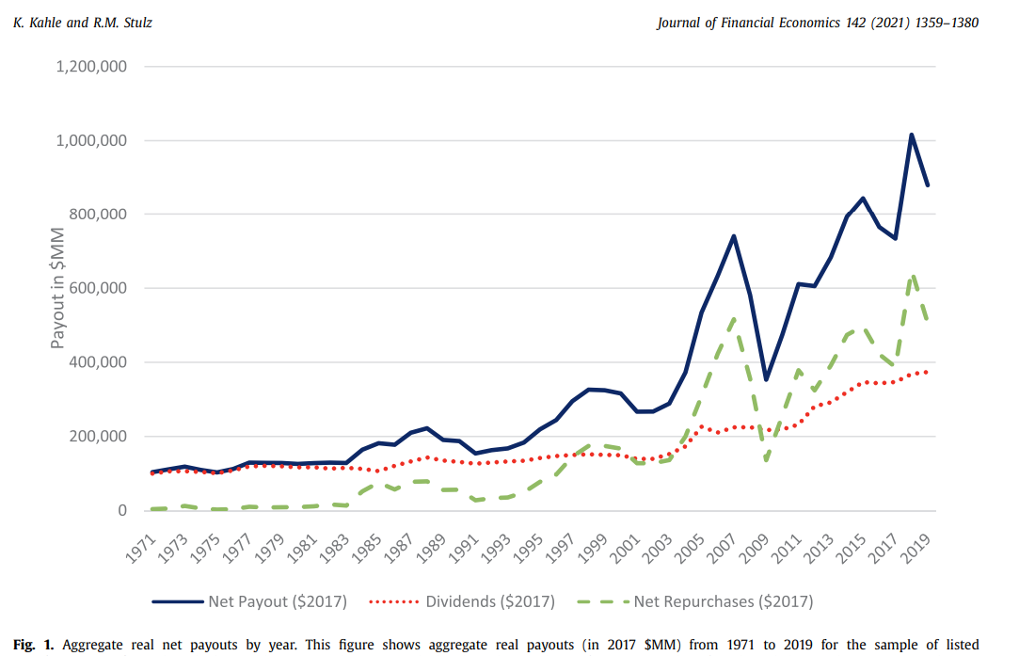
Aggregate constant dollar payouts
2008: financial crisis
2018 peak: Tax Cuts and Jobs Acts become effective

Slide 5
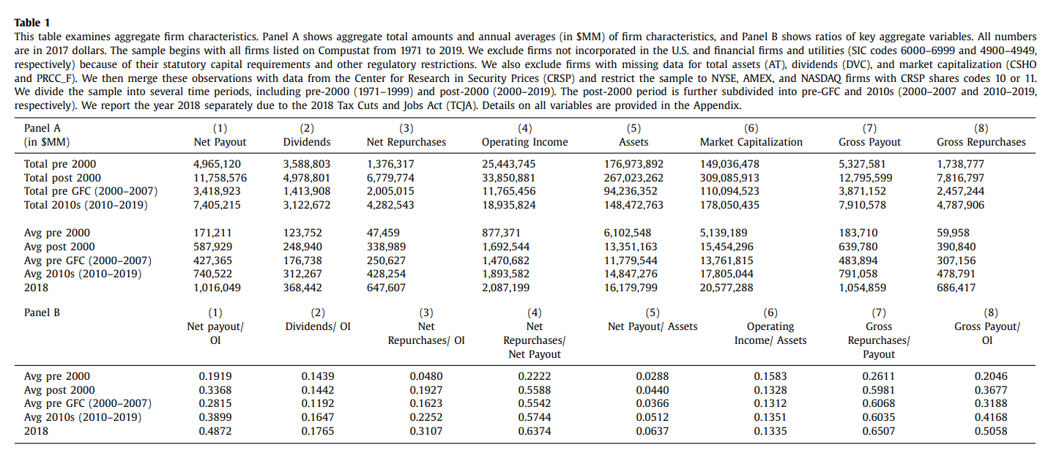
Aggregate constant dollar payouts

Slide 6
Table 1 Takeaway
The annual average of aggregate operating income increases less than the annual average of payouts between the pre-2000s and the 2000s
The increase in the payout rate between the pre-2000s and the 2000s is entirely due to an increase in the repurchase rate. The dividend payout rate is almost the same for both periods.

Slide 7
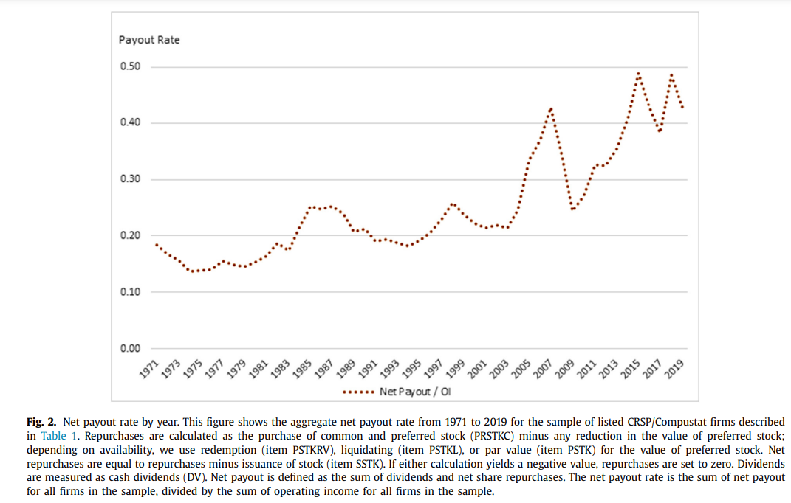
Aggregate constant dollar payouts

Slide 8
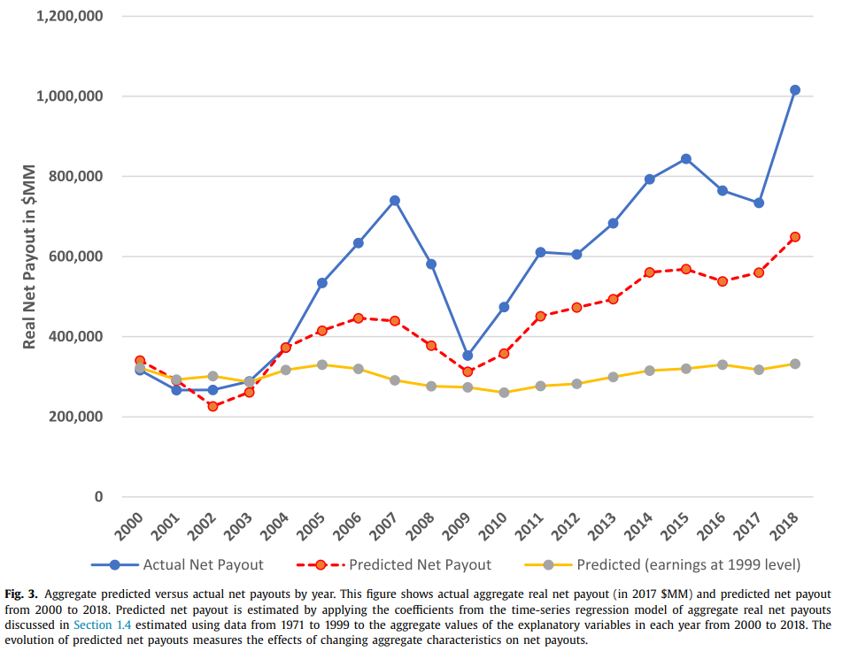
Variable construction and summary statistics
Use earnings and macro variables to predict aggregate payout. Freeze earnings at their 1999 level when predicting the values
Macroeconomic variables do not help predict aggregate payouts once one accounts for aggregate earnings

Slide 9
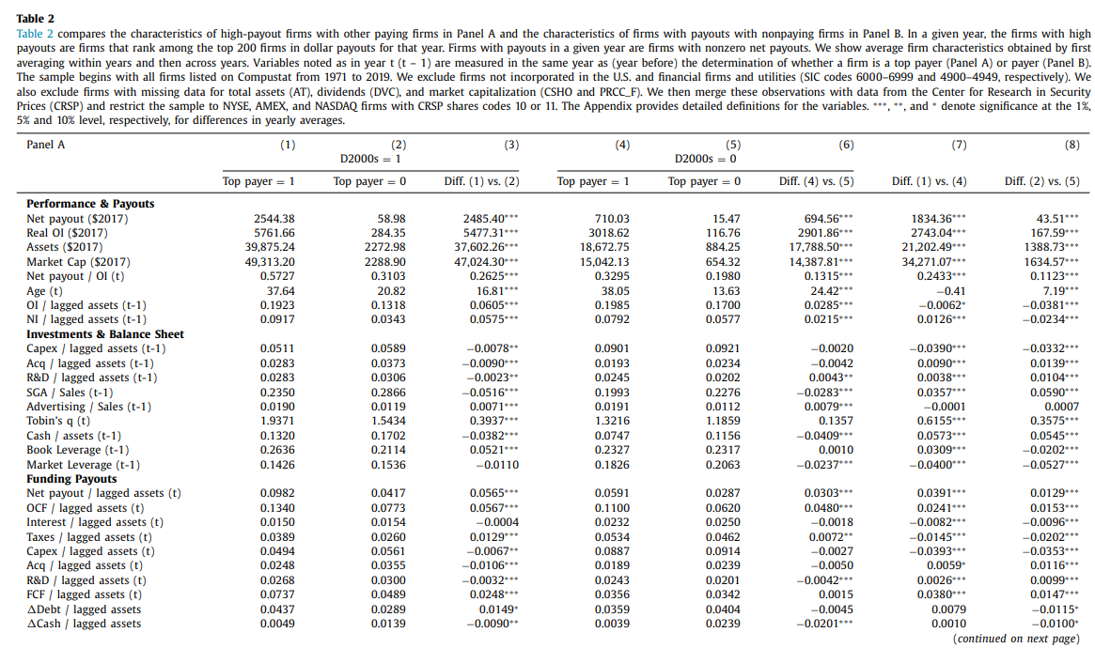
Firm payouts and performance
the real payouts of the top payers increase sharply, but
they do not increase more in percentage terms than for the other payers. Neither do their operating income, assets, or market value.
Acquisitions is the same both before 20 0 0 and after
R&D increase but changes do not generate funds for payouts.
Nonpayers have much greater SG&A than payers. increases by half that amount.
Cash holdings are higher in the 20 0 0s for all types of firms

Slide 10
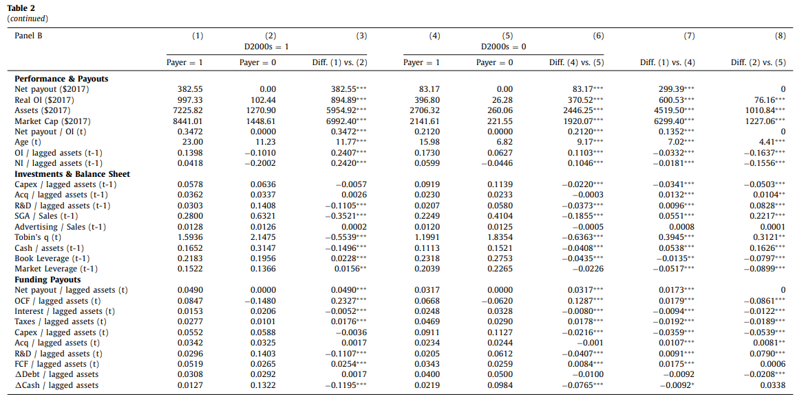
Firm payouts and performance
Real operating income, assets, and market value increase much more for non- payers.
Nonpayers have much greater SG&A than payers. increases by half that amount.
A sharp drop in the number of listed firms in the 20 0 0s increases firm size;
low level of IPOs causes an increase in the age of firms

Slide 11
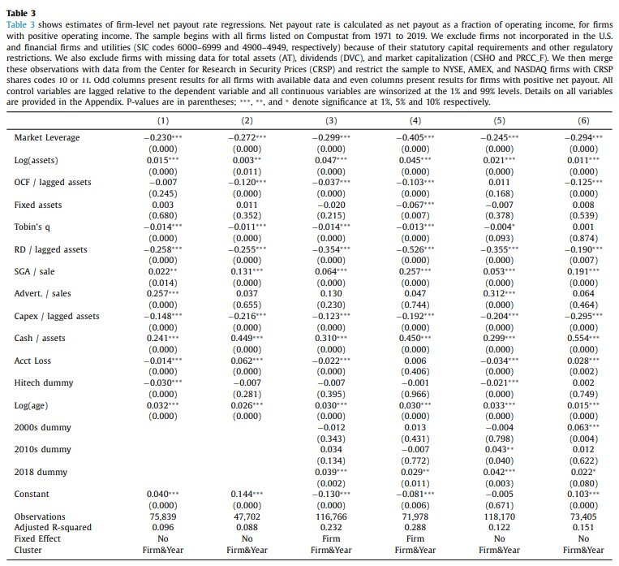
Column 1, 3 and 5: All firms
Column 2, 4 and 6: Payers only
2010s dummy: a significant positive indicator variable for the 2010s indicates that the payout rate is higher in the 2010s than in the 20 0 0s
Column 3 &4: firms do not set their payout rate differently in the 20 0 0s and 2010s than they do before 20 0 0
when we drop firm fixed effects, we observe changes in the intercepts for the 20 0 0s and the 2010s, indicating that new firms enter the sample in the 20 0 0s with elevated payout rates given their characteristics.

Slide 12
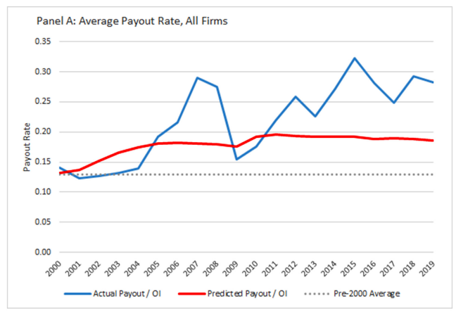
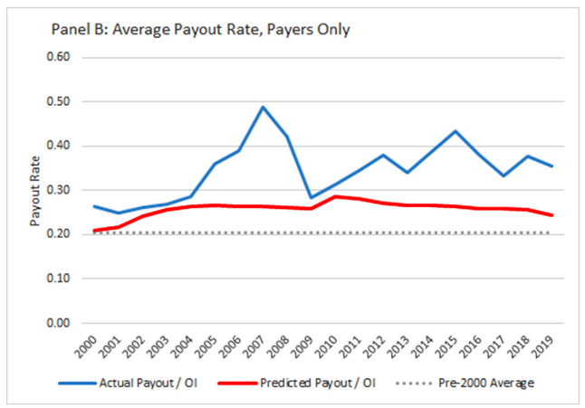
Predicting Payouts in the 2000s _Fig. 4
Panel A uses all firms. On average, the predicted values for the 20 0 0s are close to, but lower than, the actual values.
Panel B : an increase in average payout rates is predicted in the 20 0 0s; the predicted net payout rate of payers is below the actual net payout rate every year.

Slide 13
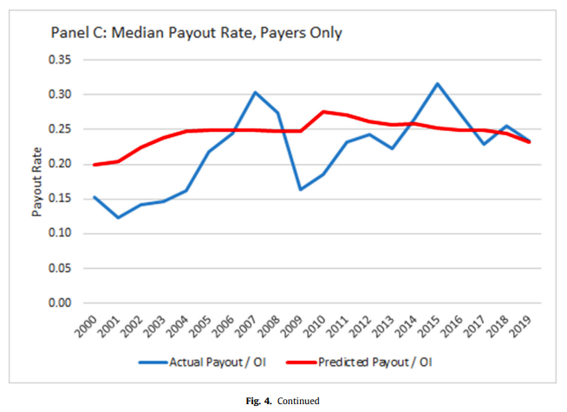
Predicting Payouts in the 2000s
Panel C, shows predicted and actual median payouts. Whereas the model underpredicts the mean, it overpredicts the median in most years.

Slide 14
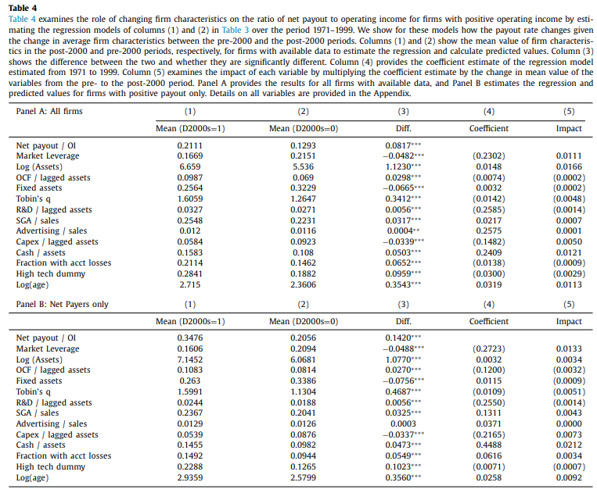
Which firm Characteristics matter most?
Impact=Diff*Coefficient
Panel A
the payout rate increases by 8.17 percentage points, and changes in firm characteristics explain an increase of 4.65 percentage points
Panel B
the payout rate increases by 14.20 percentage points, and changes in firm characteristics predict a change of 5.07 percentage points

Slide 15
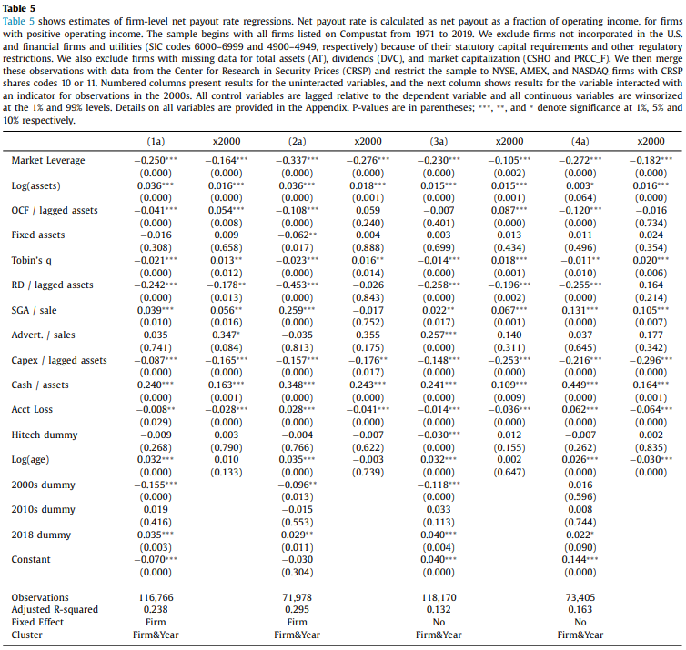


In Table 5 , we re-estimate the models in columns (3) through (6) of Table 3, but we allow the slopes and the intercepts to change in the 20 0 0s by including period indicator variables and interacting the 20 0 0s indicator with firm characteristics.
when interactions with market leverage, log of assets, capital expenditures, cash holdings, and R&D have significant coefficients, the interactions imply changes in these variables have a larger effect in the 20 0 0s on the predicted payout rate than before

Slide 16
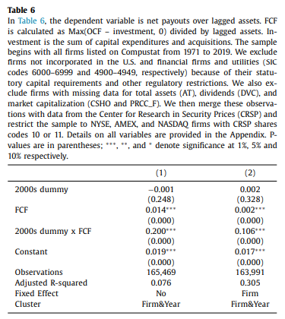
The sensitivity of payouts to FCF is much higher in the 2000s

Slide 17
Conclusions
The average annual inflation-adjusted amount paid out through dividends and repurchases by public industrial firms is more than three times larger from 2000 to 2019 than from 1971 to 1999.
An increase in aggregate corporate income accounts for 37% of the increase in aggregate annual payouts, and an increase in the payout rate accounts for 63%.
Firms have higher payout rates in the 2000s not only because they are older, larger, and have more free cash flow, but also because they pay out more of their free cash flow
Firms spend less on capital expenditures in the 2000s than before, and capital expenditures decrease similarly for firms with payouts and for firms without.

Slide 18
Thank you!

